Slide 1

Center for Educational Leadership’s (CEL)
5 Dimensions of Teaching and Learning™ and 5D+™ Teacher Evaluation Rubrics
Colin Ripmaster, MASSP Associate Director
Notes:
Good afternoon, my name is Colin Ripmaster the associate director at MASSP. I am a representative of the Center for Educational Leadership that provides much of the consultation and training for CEL’s 5 Dimensions of Teaching and Learning Instructional Framework and 5D+ Teacher Evaluation Rubrics in Michigan.
The Center for Educational Research is a nonprofit service arm of the University of Washington’s College of Education, one of the top education schools in the country. As a part of a Tier I research institute, the Center for Educational Leadership continually engages in the review of research on effective teaching and learning that informs their instructional framework, evaluation rubric, and trainings.
Since the MCEE Pilot, nearly 100 districts in Michigan have selected CEL’s instructional framework and rubric for use in their district from all regions of the state. In addition, we work directly with districts throughout the nation that range in size from 40 students at a small island school in Northern Michigan to 40,000 students in Portland, OR.

Slide 2
Research - Base
Three types of sources were investigated, which included:
  empirically based studies of teaching and coaching practice,
  practitioner-oriented prescriptions and frameworks for instructional and coaching practice, and
  descriptions of practice from an identified panel of expert observers who included instructional coaches and school administrators working daily with teachers on improving practice.
Framework and Rubric
tinyurl.com/o9n2vej
Rater Reliability
tinyurl.com/kyr69ut
Notes:
The research on teacher quality as the primary correlate for student achievement is unequivocal - teaching matters above all else, including family income and education (Haycock, 1998; Peske & Haycock, 2006).
A close examination of variance in student achievement across the country yields once again that differences among students, as well as schools, are but a small factor compared to differences in the quality of teaching from classroom to classroom (Rowan, Correnti, & Miller, 2002).
There is also a growing body of research evidence that suggests leadership is only second to teaching as the highest correlate to student achievement (Leithwood, Louis, Anderson & Wahlstrom, 2004) and that clarifies the important relationship school district central office leaders can play in supporting student learning across a system (Copland & Knapp, 2006; Honig, 2008; Wahlstrom, Seashore, Leithwood & Anderson, 2010).
These realities drive CEL’s mission and focused its work on an instructional framework to help educators identify and strengthen effective instruction.

Slide 3
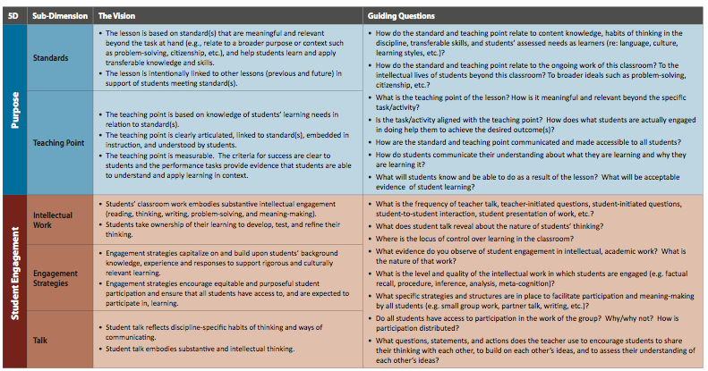
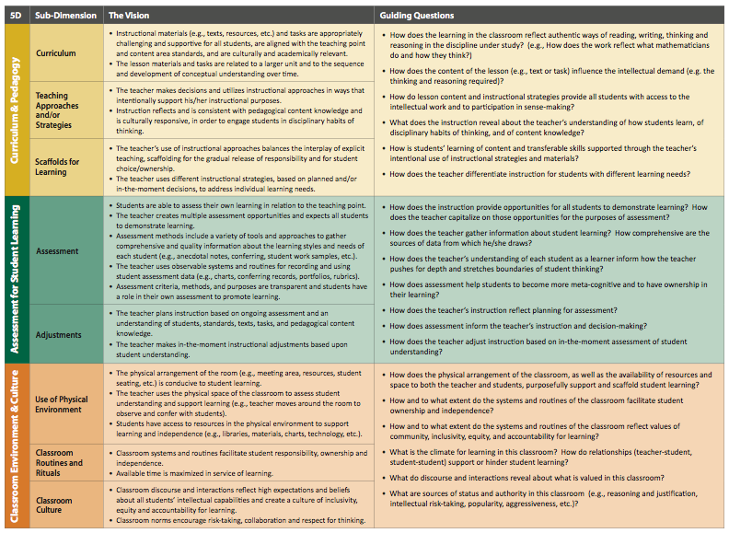
Research - Base
tinyurl.com/n8jh2mv
Notes:
The Center for Instructional Leadership’s (CEL’s) instructional framework was derived from extensive research on what constitutes high-quality instruction, informed by the experiences of practitioners.
We realize how critical it is to provide building leaders and teachers with the skills necessary to support excellent classroom practice and we also know that this work needs to be thoughtful, intentional, and focused.
CEL’s research-based instructional framework, the 5 Dimensions of Teaching and Learning summarizes the research on high-quality instruction and articulates it within each bullet of the vision statements.
5D isn’t a checklist. Good teaching is too complex to be reduced to a single set of behaviors that are constantly observable. Leaders are learners - principals and teachers model learning for students by using an inquiry process. The framework was created for leaders to lead around instructional practice, using growth and inquiry. It is both accessible and actionable for teachers and principals. The guiding questions support inquiry and growth. The “snapshot” of teacher practice is turned into a movie as a result of the data that is brought into the process.
As you examine the instructional framework more closely you will note that there is an emphasis on continuous improvement and that equity is embedded in each dimensions.
By providing a common language and shared vision of high quality instruction we will ensure our expectations are not a mystery. By focusing on continuous improvement and equity we will more likely achieve our mission of eliminating the achievement gap the divides our nation’s children along lines of race, class, language and disability.

Slide 4

5D+ Teacher Evaluation Rubric
Purpose
Student Engagement
Curriculum & Pedagogy
Assessment for Student Learning
Classroom Environment & Culture
Professional Collaboration and Communication
tinyurl.com/kr7rof2
Notes:
Using its extensive research and ten-year knowledge base working with teachers and leaders, CEL developed a four-tier rubric for the five dimensions of teaching and learning and an additional dimension specific to professional practice.
University of Washington assessment experts conducted multiple reviews of the instructional framework and the rubric to ensure language consistency, validity, and measurability.
The first 5 dimensions are specific to classroom practice.
Purpose is about both Planning and Instruction. From the standpoint of planning we are looking for teachers to design lessons that are aligned to Standards, link to broader purpose and transferable skill, and ensure connection between previous and future lessons based on what we know about our students learning needs. From the standpoint of instruction, we are looking for teachers to be explicit with students about the purpose of the lesson and provide opportunities for students to reflect upon their learning in relation to the student success criteria.
Student Engagement is about the type of intellectual work that students engage, strategies used by the teacher to support equitable access, as well as expectations that all students are provided the opportunity to develop, test, and refine their thinking.
Curriculum & Pedagogy is about the teachers understanding of key concepts and knowledge of the discipline, specific teaching approaches and/or strategies in their toolbox to support all students in accessing content and engaging in subject-matter-specific thinking/doing, and the scaffolds for learning they employ to develop student independence with targeted concepts/skills.
Assessment for Student Learning is about both the assessment opportunities and strategies used by teachers and students to inform the learning process, the adjustments made by the teacher and targeted feedback given to students.
Classroom Environment and Culture is specific to the use of the physical environment to promote and scaffold independence and ownership, the classroom routines and rituals that promote community, equity and accountability for learning, and a classroom culture that promotes high expectations, inclusivity, risk-taking and collaboration.
The last Dimension, Professional Collaboration and Communication is the “+” in 5D+. It focuses on a teachers practice beyond the classroom more specifically their contribution to professional learning and collaboration, communication with parents/guardians and school personnel, and professional responsibilities.

Slide 5
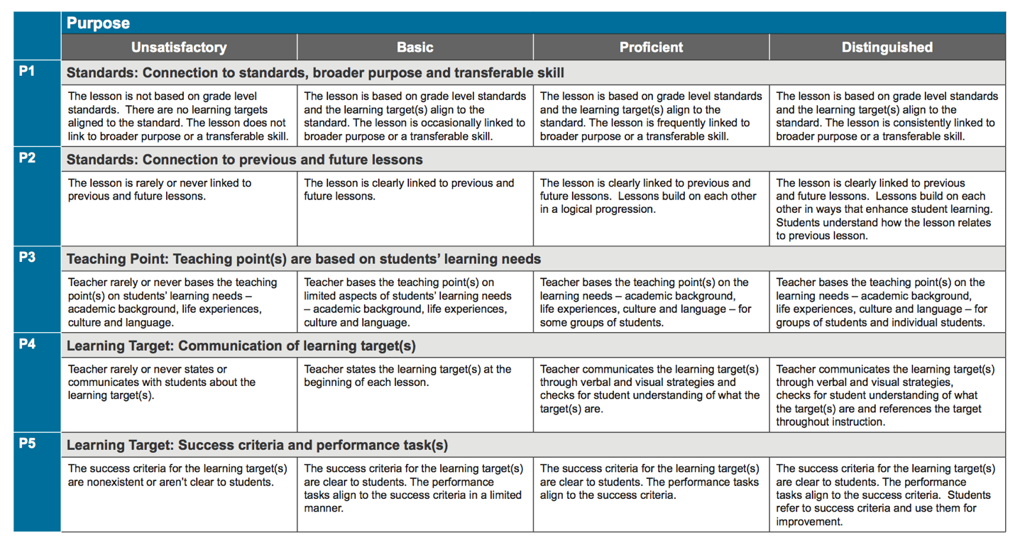
Format of Design
Notes:
Each of the 6 rubrics are organized in a consistent pattern.

Slide 6

Format of Design
Purpose
Dimension
Notes:
In the left hand corner is the name of the dimension. In this case Purpose.

Slide 7
Format of Design
Standards: Connection to standard, broader purpose and transferable skill
Subdimension
Notes:
In the gray row before the colon you will note the sub-dimension. In this case Standards.

Slide 8
Format of Design
Standard: Connection to standard, broader purpose and transferable skill
Indicator
Notes:
Following the Subdimension after the colon is the indicator.
The indicator is a reflection of a single best practice...psychometricians will tell you each rubric statement should only measure one practice at a time, otherwise you can’t ensure reliability.
In this case the single best practice is the lesson. More specifically the lesson having a connection to standards, broader purpose and transferable skill.

Slide 9
Format of Design
P1
Indicator Number
Notes:
To the left of the sub dimension you will note an indicator number, or code. Following the scripting of an observation, we code the script in order to relate the evidence collected back to one or more indicators for formative feedback, as well as summative scoring at the end of the year.

Slide 10
Format of Design
Unsatisfactory | Basic | Proficient | Distinguished
Performance Levels
Notes:
Across the top in the dark gray row you will note the performance levels.

Slide 11
Format of Design
Teacher rarely or never states or communicates with students about the learning target(s). | Teacher states the learning target(s) at the beginning of each lesson. | Teacher Communicates the learning target(s) through verbal and visual strategies and checks for understanding of what the target(s) are. | Teacher Communicates the learning target(s) through verbal and visual strategies and checks for understanding of what the target(s) are and references the target throughout the lesson.
Progressive Performance Level Language
Notes:
In the cells below each indicator you will note the specific performance language that articulates specific levels of performance. You always start at the Basic level. Move to Proficient if there is evidence to support all parts of the Basic performance level. Move to Distinguished if there is evidence to support all parts of the Proficient performance level. Performance is rated at the highest level there is evidence of all parts of a performance level.
You will note a teacher whose current practice at the basic level states the learning target at the beginning of the lesson. While a teacher whose practice is at the proficient level states the learning target through verbal and visual strategies and checks for student understanding of what the targets are. A teacher whose practice is at the distinguished level of P4, not only communicate the learning target verbally and visually and check for understanding, but also references it throughout the lesson. On the other hand a teacher who rarely or never communicates the learning target is considered to be unsatisfactory for this indicator.

Slide 12
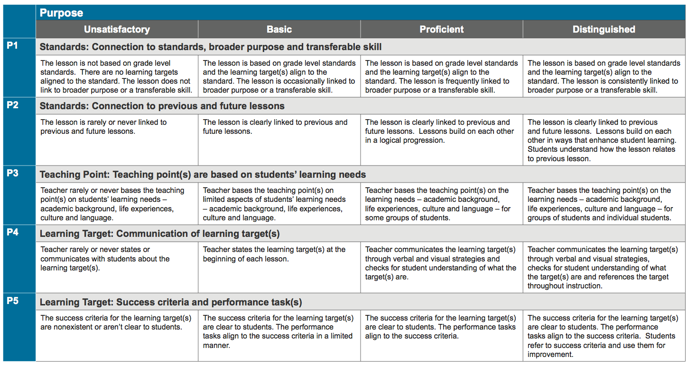
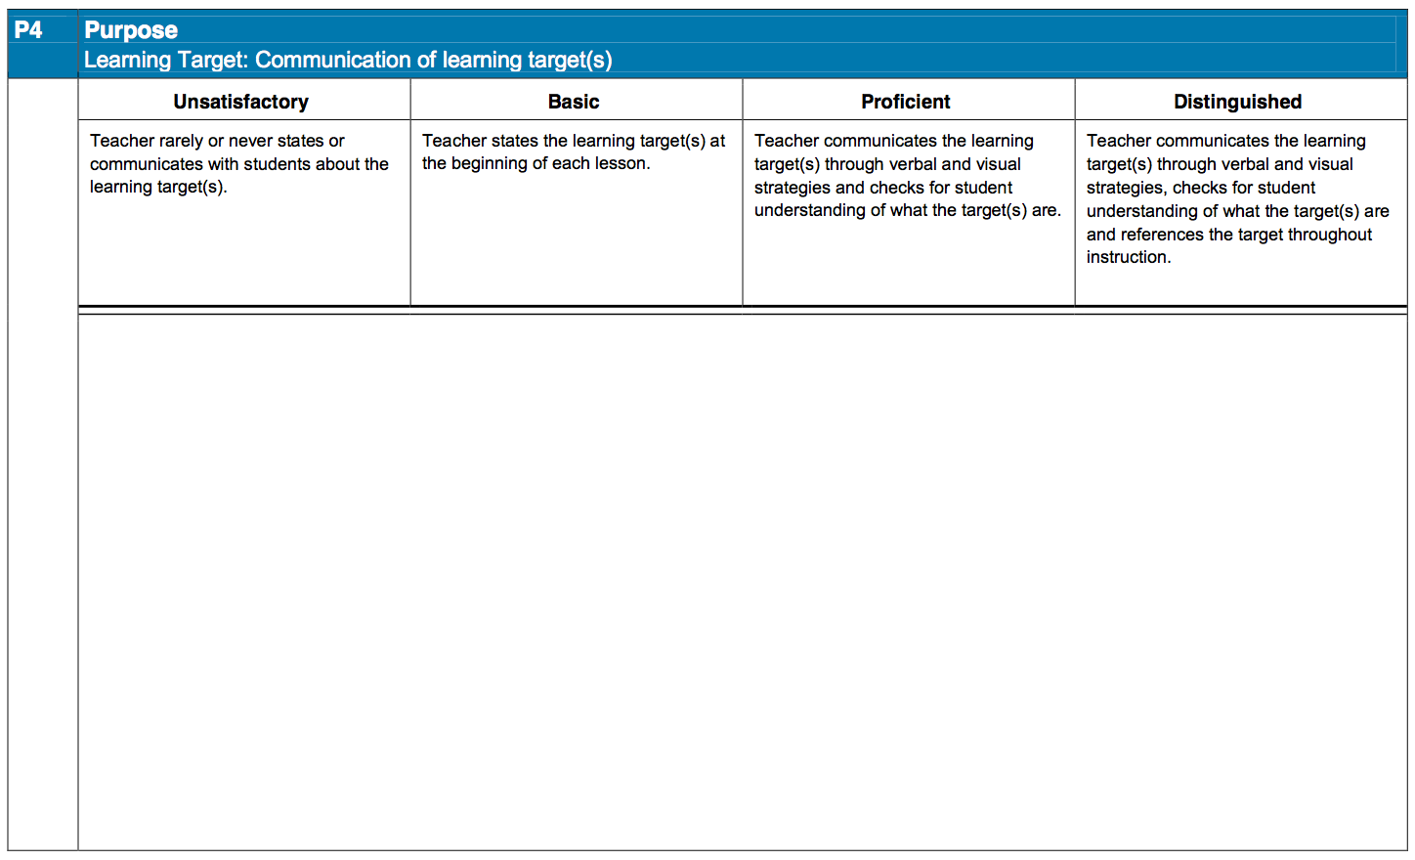
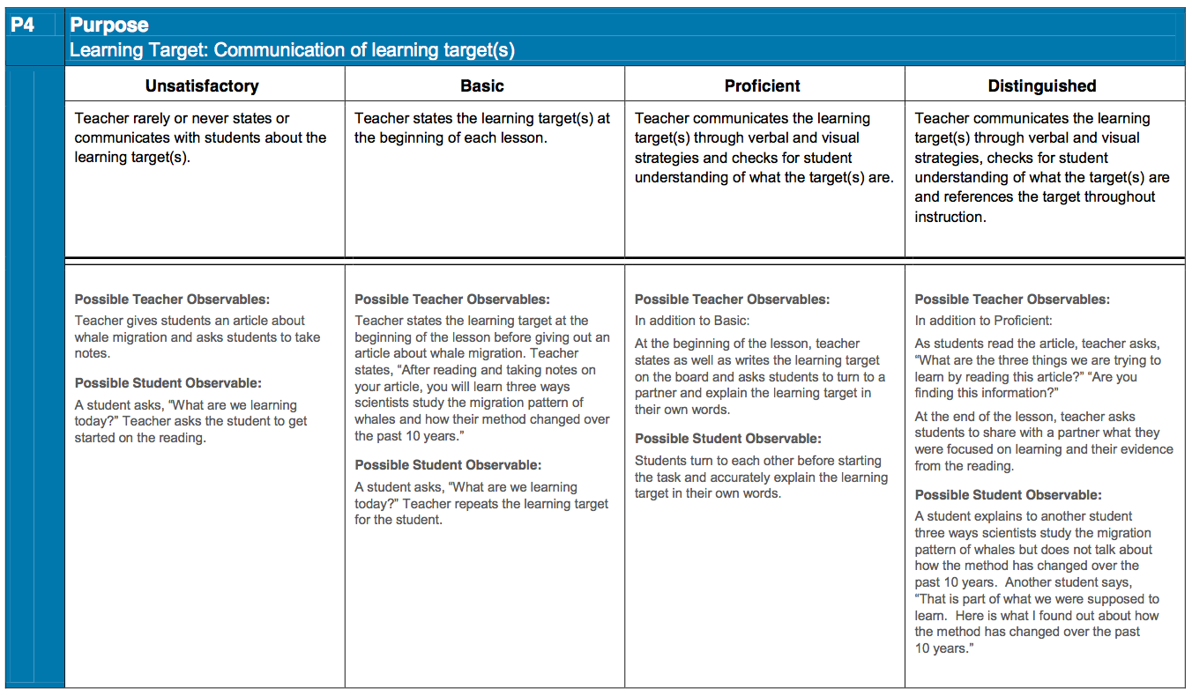
Format of Design
Notes:
The rubric comes in three formats.
The first is the rubric without possible observables. This format of the rubric is most often used for instructional purposes and scoring.
The second rubric is formatted with one indicator per page. This format is most often used for self-assessment in districts preferring to go low tech, and/or a tool for individual and teams of teachers to identify what current practices and initiatives look like at each performance level.
The third rubric is formatted with one indicator per page and possible examples of teacher and student observables. Please note we are intentional about possible examples. Possible examples aren’t exemplars or one right way of doing a practice.

Slide 13
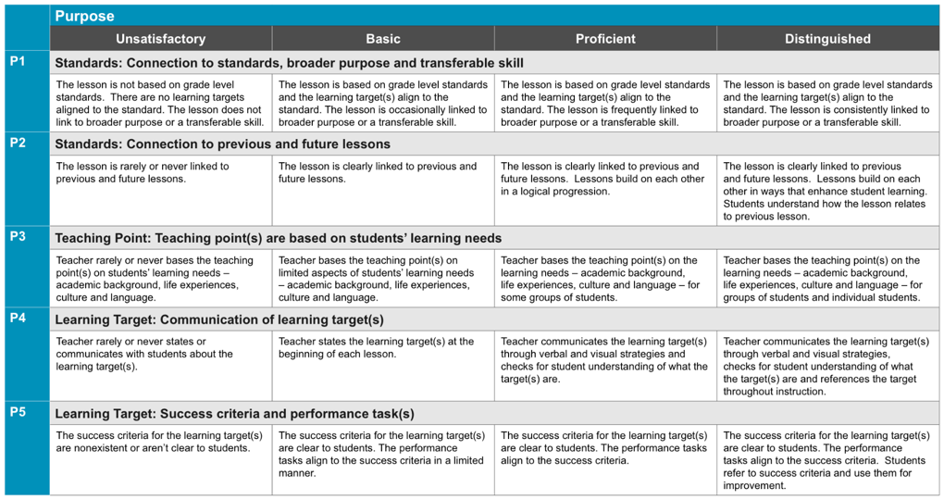
Designs lessons that aligns to Standards (CCSS/GLCE/HSCE/CTE/IB/AP).
Link to broader purpose or transferable skill
Connection to previous and future lesson.
Learning target linked to standards and measurable.
Teaching points linked to knowledge of student learning needs.
Planning

Slide 14
Ensures students understand the purpose.
Provides opportunities for students to reflect upon their learning in relationship to the success criteria.
Instruction

Slide 15
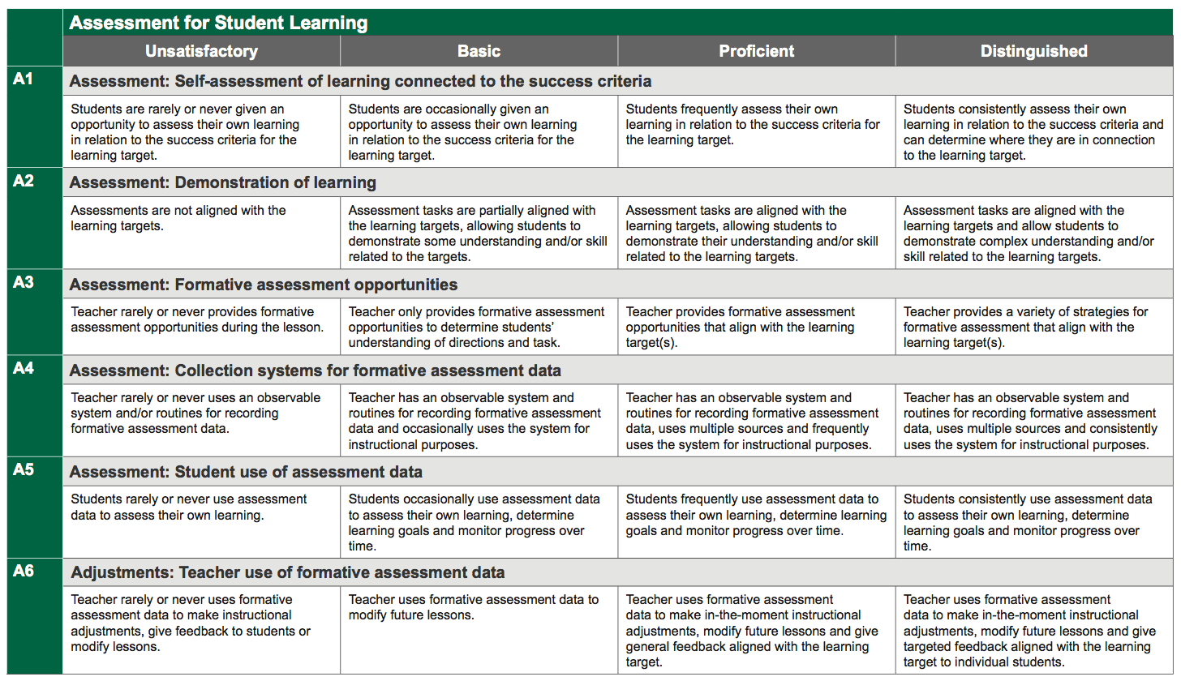
All students have opportunities to demonstrate learning.
The teacher has a system to gather and record assessment information.
Variety of ways to collect assessment data.
All students have self-assessment opportunities.
Assessments
Instructional decisions reflect use of data.
Targeted feedback to students.
Adjustments
Notes:
Each of the rubrics are organized in a consistent pattern.

Slide 16
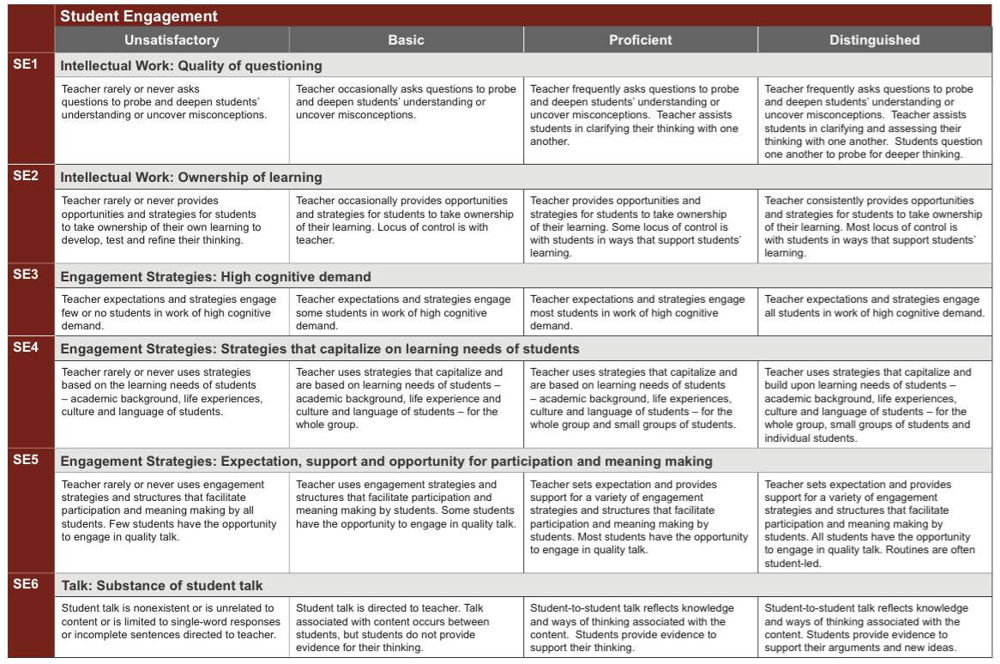
Reflects thinking and work of the discipline and CCSS.
Student-owned.
Intellectual Work
Supports equitable access and expectations that all participate.
Capitalize on the learning needs of students (academic background, life experiences, culture and language).
Engagement Strategies
Opportunities for students to develop, test, and refine their thinking.
Talk
Notes:
Each of the rubrics are organized in a consistent pattern.

Slide 17
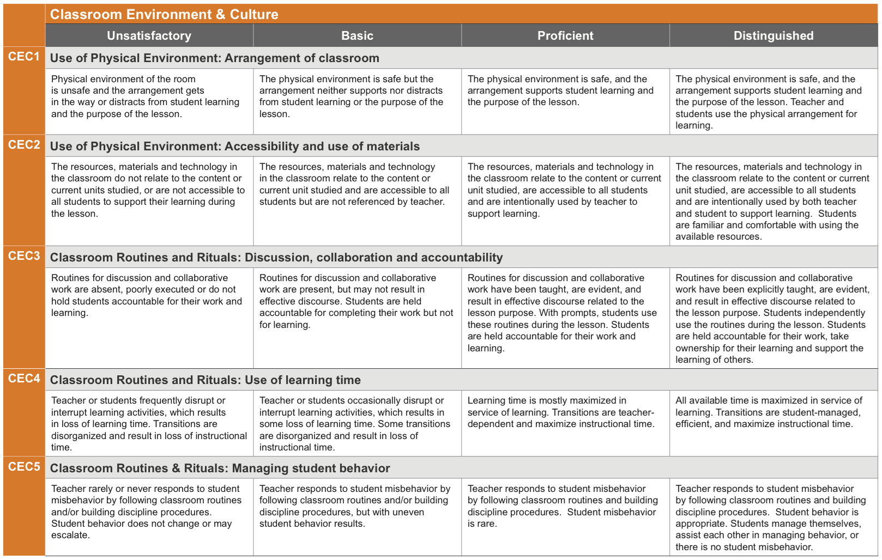
Set up to promote and scaffold independence and ownership.
Use of Physical Environment
Promote community, equity and accountability for learning.
Classroom Routines and Rituals
Notes:
Each of the rubrics are organized in a consistent pattern.

Slide 18
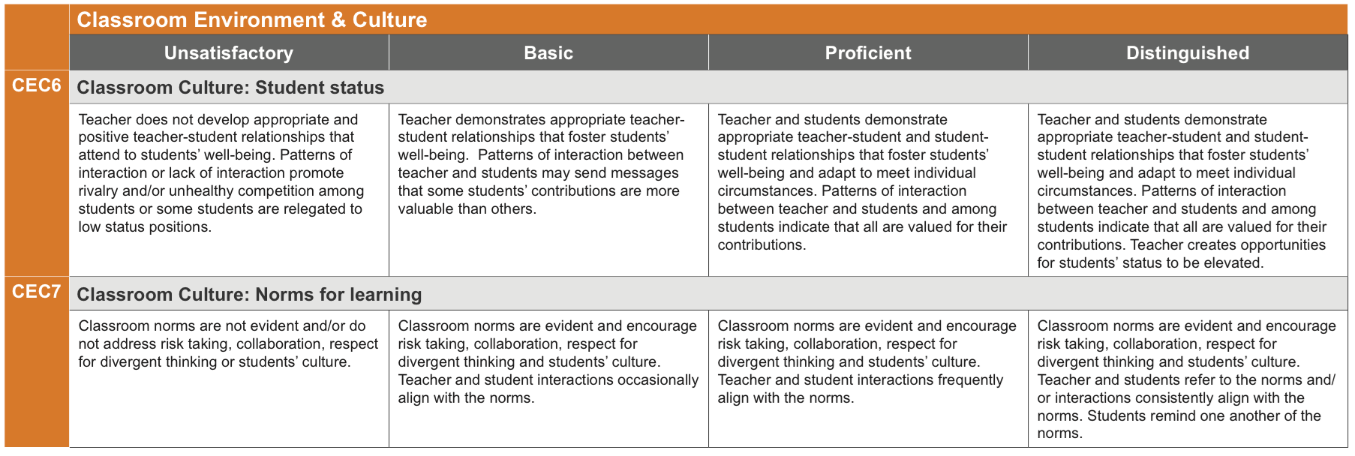
Based upon relationships that promote high expectations and inclusivity while reducing issues of status.
Promote risk-taking and collaboration.
Classroom Culture

Slide 19
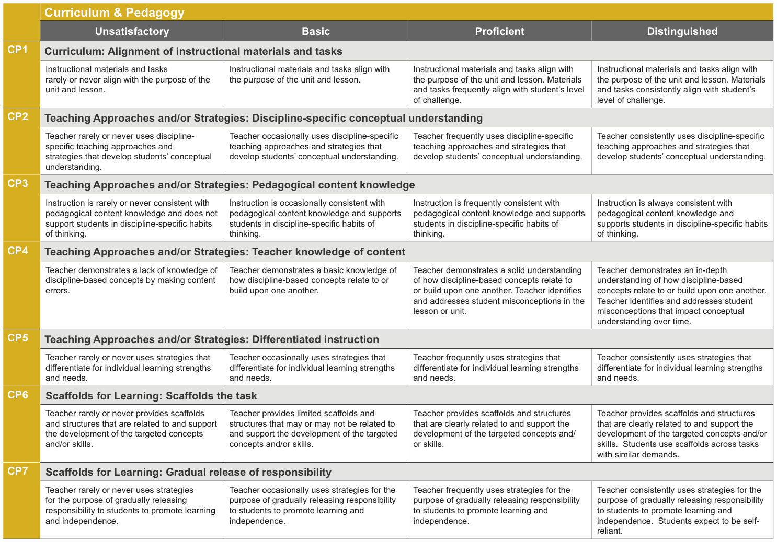
Based on key concepts and knowledge of a discipline.
Instructional materials are appropriately challenging and supportive for all students.
Curriculum
Support all students in accessing content and engaging in subject-matter-specific thinking/doing.
Teaching Approaches and/or Strategies
Build towards student independence with targeted concepts/skills.
Scaffolds for Learning
Notes:
Each of the rubrics are organized in a consistent pattern.

Slide 20
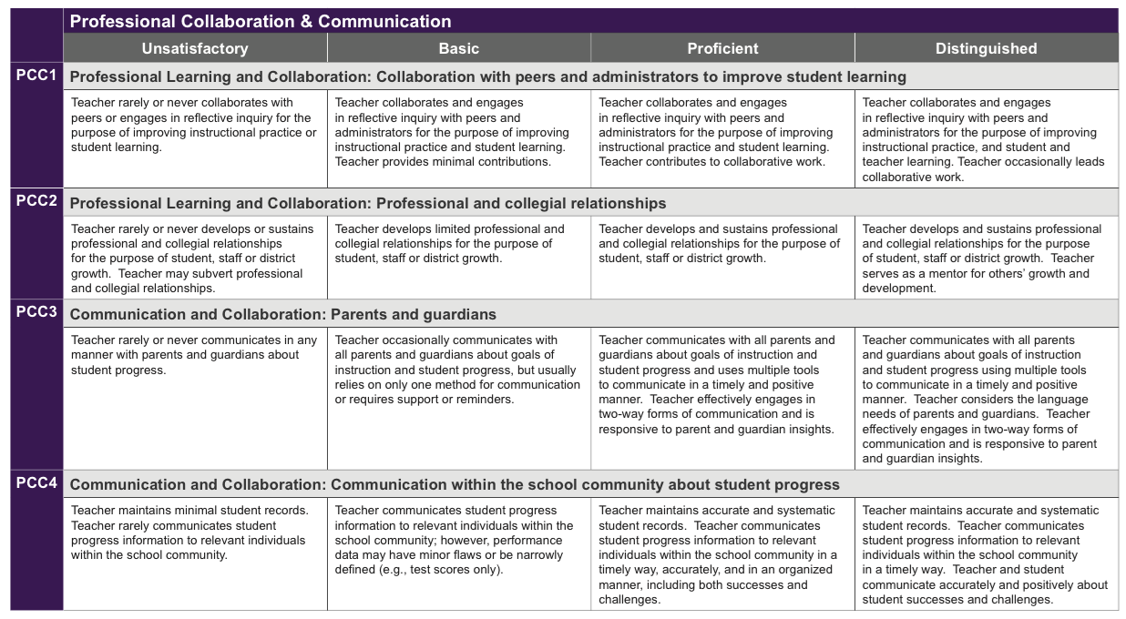
Establishes professional relationships
Contributes to collaborative learning for the purpose of improving student learning and teacher growth.
Professional Learning and Collaboration
Communicates about student progress,
Keeps accurate records
Uses records to help the school community be more effective and responsive to student needs.
Communication and Collaboration

Slide 21
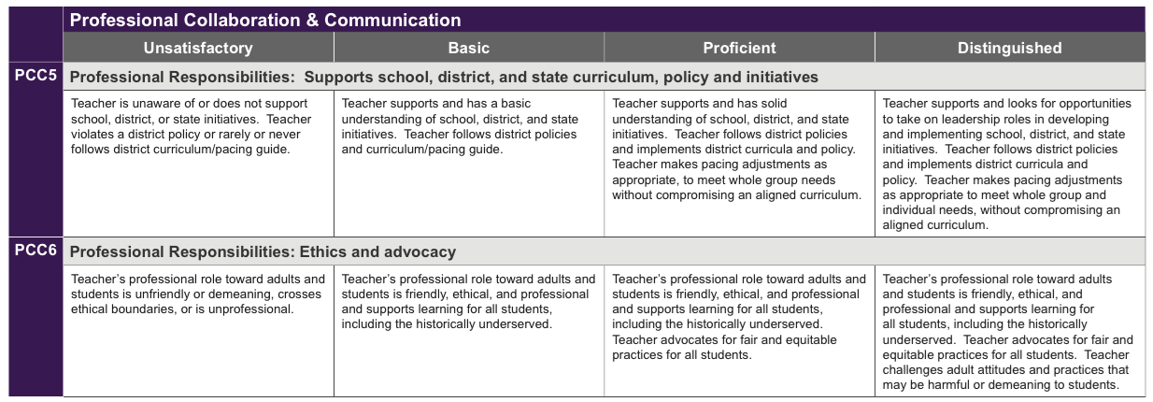
Supports building, district and state initiatives, policy and curriculum
Behavior is ethical and professional.
Advocates for equitable practices for all students
Professional Responsibilities

Slide 22
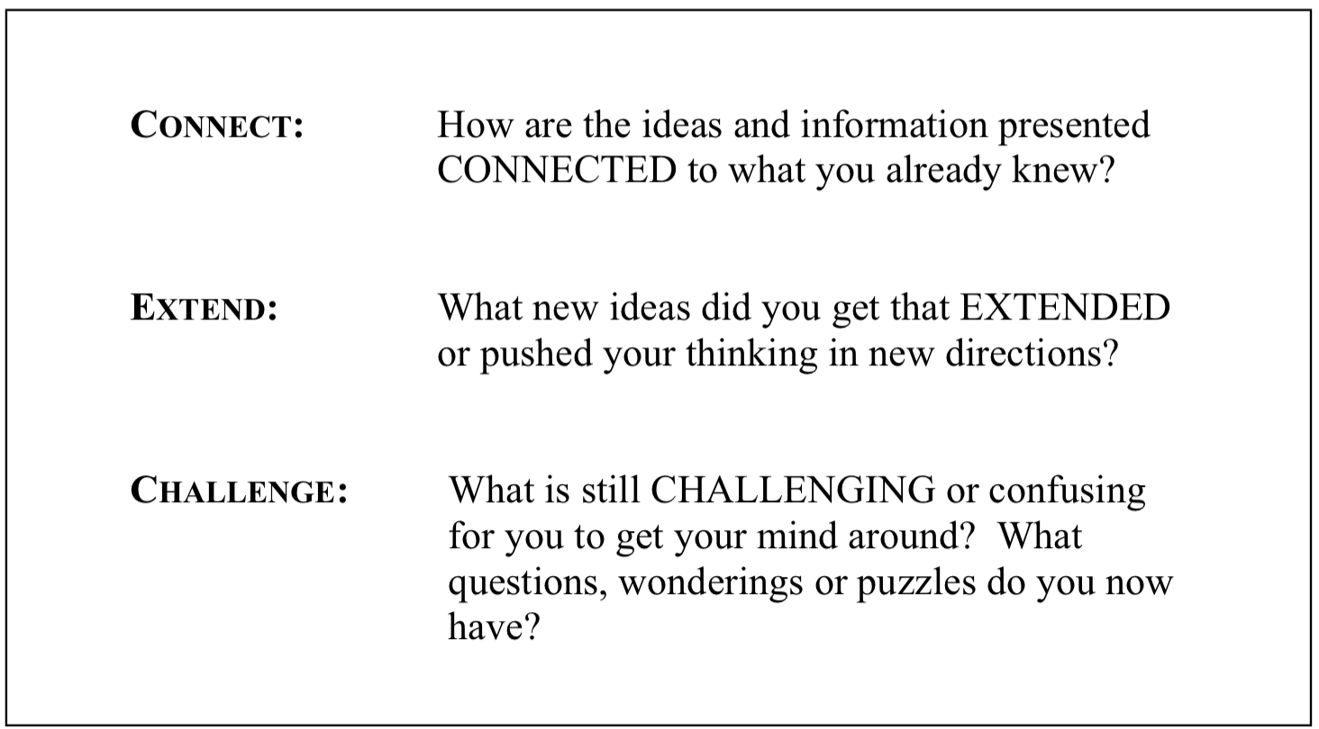
Reflection

Slide 23
Unique Features
What makes your model different from all the others?
Unwavering mission
Growth-oriented, strength based stance
Staircase to improvement; not a checklist.
Equity is embedded in each dimension.
Customized services from CEL & MI certified consultants
Proven results closing achievement gaps.
One best practice identified in each rubric line.
Vast majority of rubric can be observed in classroom practice
5D+™ inquiry cycle
Criterion scoring methodology
Notes:
Unwavering mission dedicated to eliminating the achievement gap. Our work isn’t about sorting and selecting teachers. It is about developing teachers and leaders in order to achieve our mission
Growth Model that recognizes teaching is complex and sophisticated; and improving practice is a journey, not an event. Consequently we draw upon the lessons from Vygotsky, a psychologist in the 1920’s who studied how people learn. His work showed that all learners have a zone of proximal development where they actively engage in learning. If the learning opportunity is too hard, they don’t try. If the learning opportunity is too easy, they check out. If the learning opportunity is “just right”, they engage.
Progressive performance language in the rubric provides a staircase to improvement; not a checklist. Equity is embedded in each dimension. As a center we believe it is important to call out our focus on equity and what it means to us as an organization, in order to ensure that all students experience powerful learning opportunities, have the access and support they need to learn at high levels, and a culture that cultivates a respect for difference. In doing so we will realize high levels of achievement for every student!
Comprehensive and customized services are available from both CEL and Michigan-based consultants that help districts meet their instructional improvement goals.
CEL educators and trainings have helped close the achievement gap by putting knowledge and skills that improve instructional effectiveness into the hands of classroom teachers. We work with the entire system, including district, building and classroom based educators, to ensure everyone is working as a team to improve teaching effectiveness.
One best practice identified in each rubric line. This increases clarity of expectations and strengthens reliability of the tool.
Vast majority of rubric can be observed in classroom practice, and doesn’t require examination of artifacts; reducing the burden of work for administrators and teachers that doesn’t have direct impact on classroom practice.
5D+™ inquiry cycle separates observation, interpretation and judgment; distinguishes between bias, interpretation and evidence.
Criterion Scoring Methodology (similar to standards based grading) to determine indicator, dimension and professional practice effectiveness based on the preponderance of evidence and growth over time.

Slide 24
Training
5 Day Framework Training
    1 Additional Day Summative Scoring (Optional)
On-going/Additional (recommended by State but not required)
    Feedback Institute (2 days)
    Rater Reliability (3 days)
Formats
    Online (Framework Training Only)
    Regional Sites
    In District Contracts
Notes:
MASSP in partnership with the Center for Educational Leadership provides professional development in Michigan to support the effective implementation of the 5 Dimensions of Teaching and Learning and 5D+ Teacher Evaluation Rubrics.
CEL does not have a “one-size-fits-all” professional development model. Just as we expect teachers to differentiate in their classroom based on the learning needs of their students in relationship to the standards, we support districts in differentiating implementation with their teachers and administrators. We consult with clients and work with them to find the most powerful services to address needs, based on available resources. Professional development services are available online, at regional sites and in-district depending on the needs and size of each district.
CEL’s suite of research-based services includes:
Instructional Rounds: guided walkthroughs around buildings area of focus.
Coaching: One-on-one, side-by-side work with teachers and leaders to improve the quality of education for all students.
Subject Matter Expertise: assist district leaders, administrators, coaches, and teachers build content knowledge and hone pedagogical skills.
Targeted Feedback Institute: supports principals, teachers and central office leaders in learning the skills for giving feedback and creating a culture that results in effective teacher evaluations centered on growth of teacher practice and improvement of student learning. ($250)
Classroom Instruction DVDs: Observe, analyze and discuss high-quality teaching. ($200)
Recorded Webinars (Free)
Video Library through Teaching Channel

Slide 25

Platform
iPad App
Web Based Portal
Notes:
Pivot with 5D+ is a mobile electronic tool for observations and evaluations designed for principals by principals. This electronic tool:
Tracks progress in the 5D+™ inquiry cycle.
Automates consolidation of coded data for evaluations.
Supports growth measures and student learning objectives (SLOs).
Provides custom reports and analytics.

Slide 26
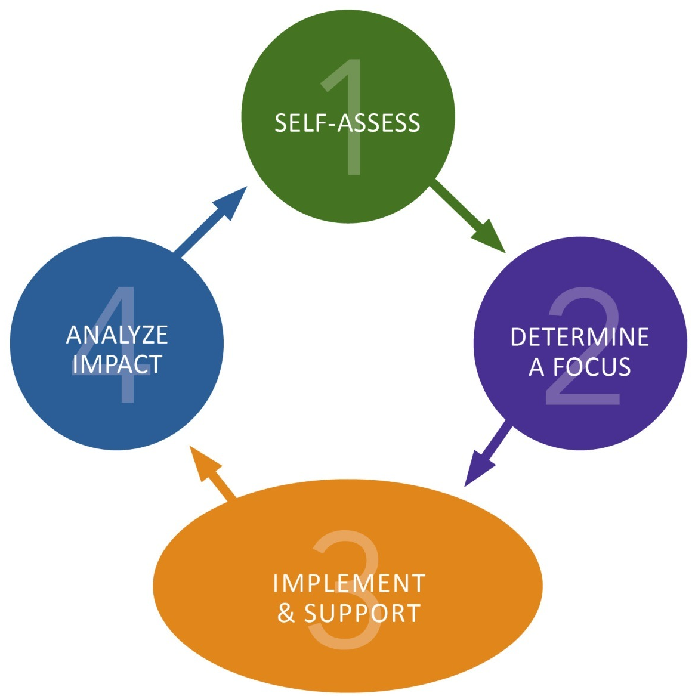
5D+ Inquiry Cycle
ANALYZE IMPACT:
Teacher and principal analyze the results of their work.
Based on your inquiry, what did you learn about your practice as it impacts student learning?
SELF-ASSESS:
Teacher self-assesses to identify an area of focus.
DETERMINE A FOCUS:
Teacher and principal analyze evidence to identify an area of focus. Based on the responses in the self-assessment, what is your area of focus? What kind of evidence will you collect?
IMPLEMENT
& SUPPPORT:
Teacher and principal engage in study and learning around area of focus.
Notes:
There are four steps to the 5D+ Inquiry Cycle and Pivot manages this workflow throughout the year.
Teachers engage in the self-assessment process and bring the results of the self-assessment to the pre-inquiry conference with the principal.
They work together to finalize the area of inquiry for the inquiry cycle during this conference.
Teachers and principals spend most of the time in step 3 in which we engage in formative cycles of observation and feedback.
At the end of the inquiry cycle, the teacher and principal review the results of the inquiry and decide together whether to continue with the same area of focus for the next inquiry cycle or to move to a new area of focus.

Slide 27
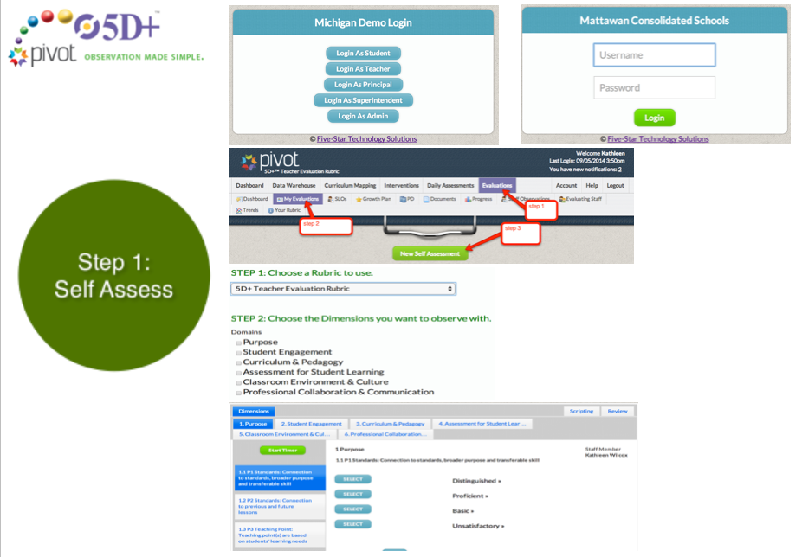

Slide 28
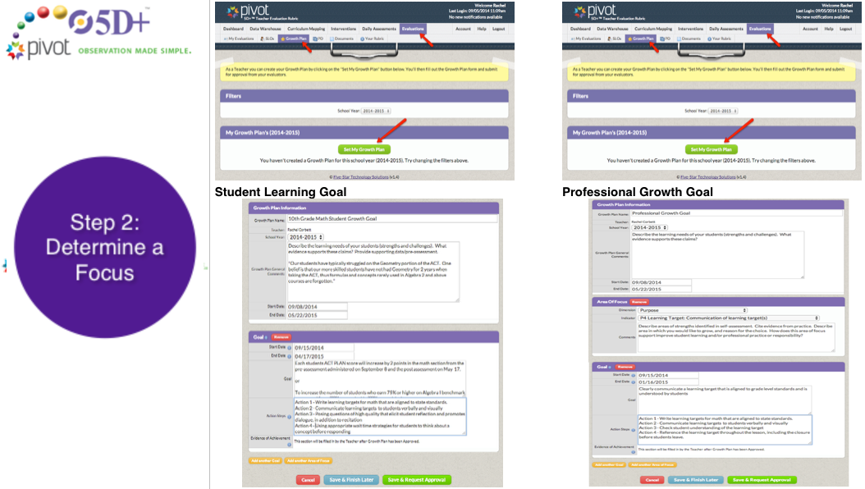

Slide 29
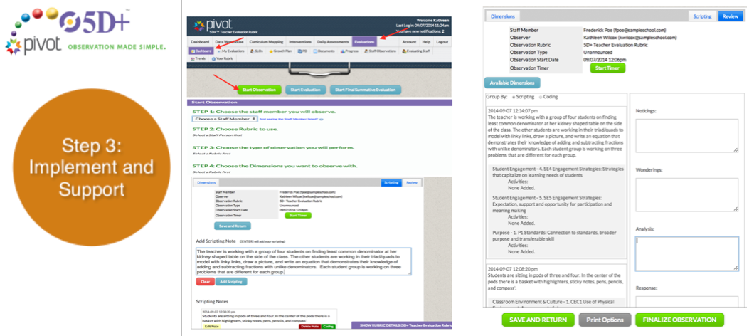

Slide 30
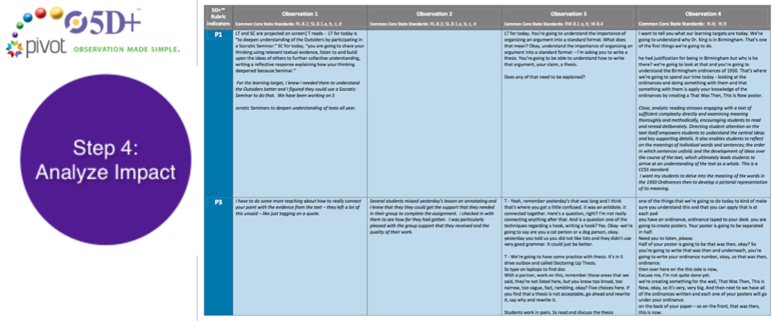

Slide 31
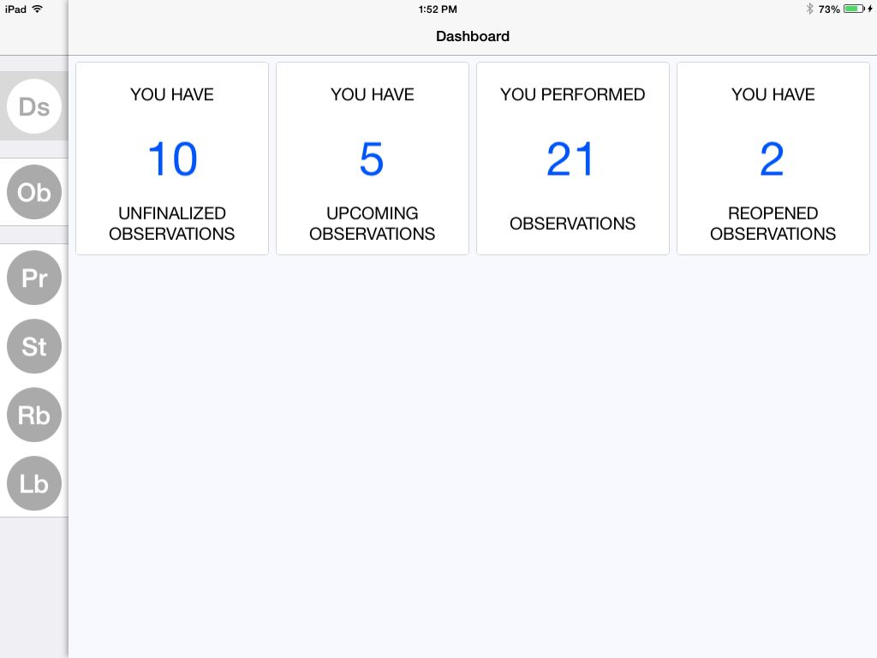
Platform
Observations Dashboard
The DS tab along the side is for Dashboard. This dashboard will also include Evaluation data.

Slide 32
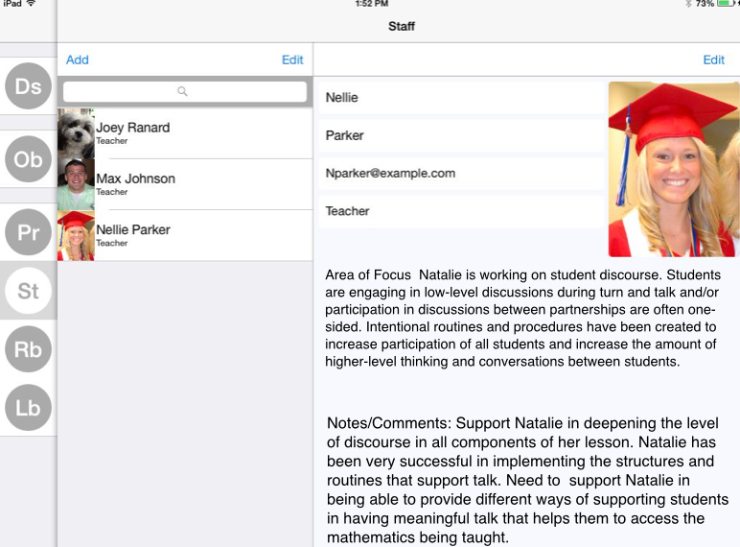
Staff Entry Screen
Platform
Add own staff members. Include demographic information and pictures.

Slide 33
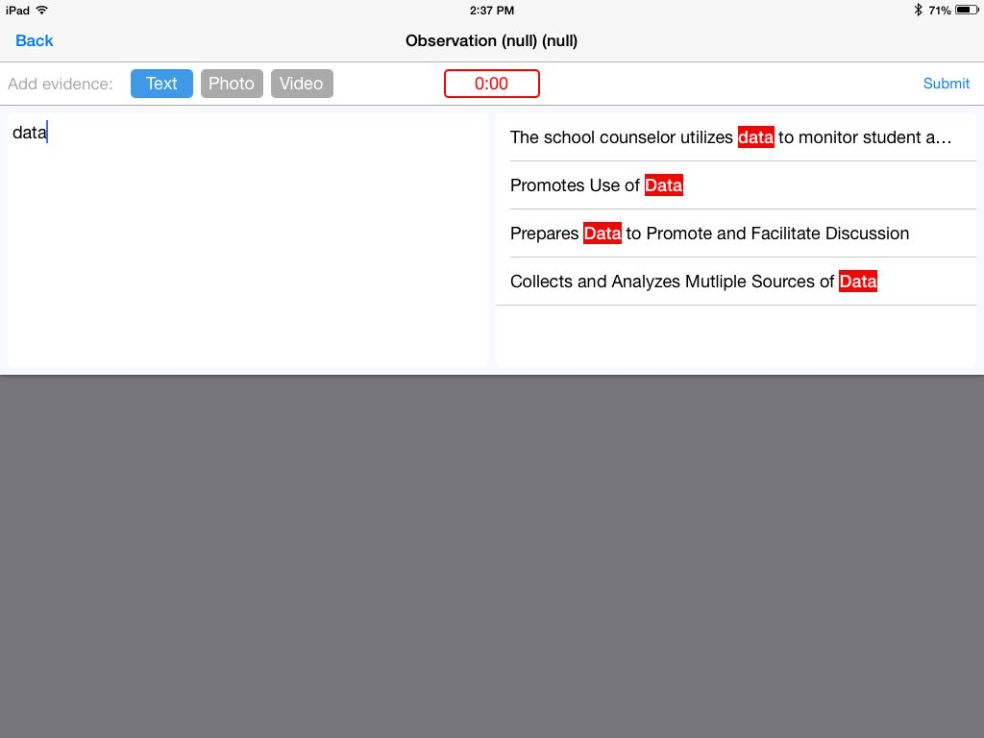
Scripting (collecting evidence)
Platform
Can add text, photo or video evidence. Smart typing allows you to type a word and it will search your phrases and your observables text from rubric to provide quick click data entry.

Slide 34
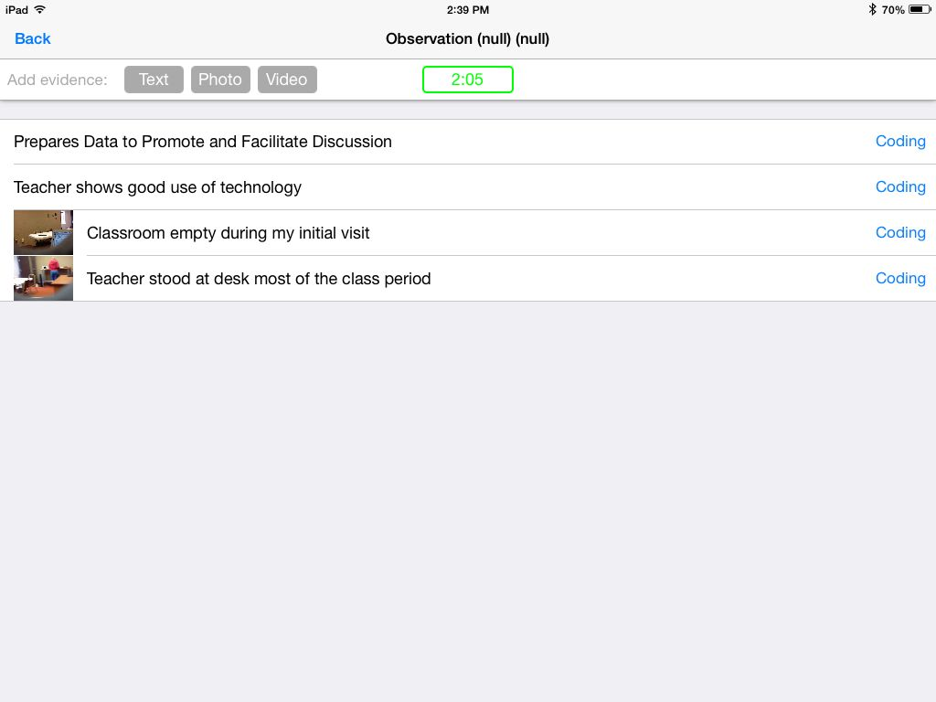
Scripting List
Platform
Text, Photo and Movie scripting list able to be coded quickly by clicking the Coding text at the end of each line. Notice the timer in green. It started automatically as soon as we saved our first script.

Slide 35
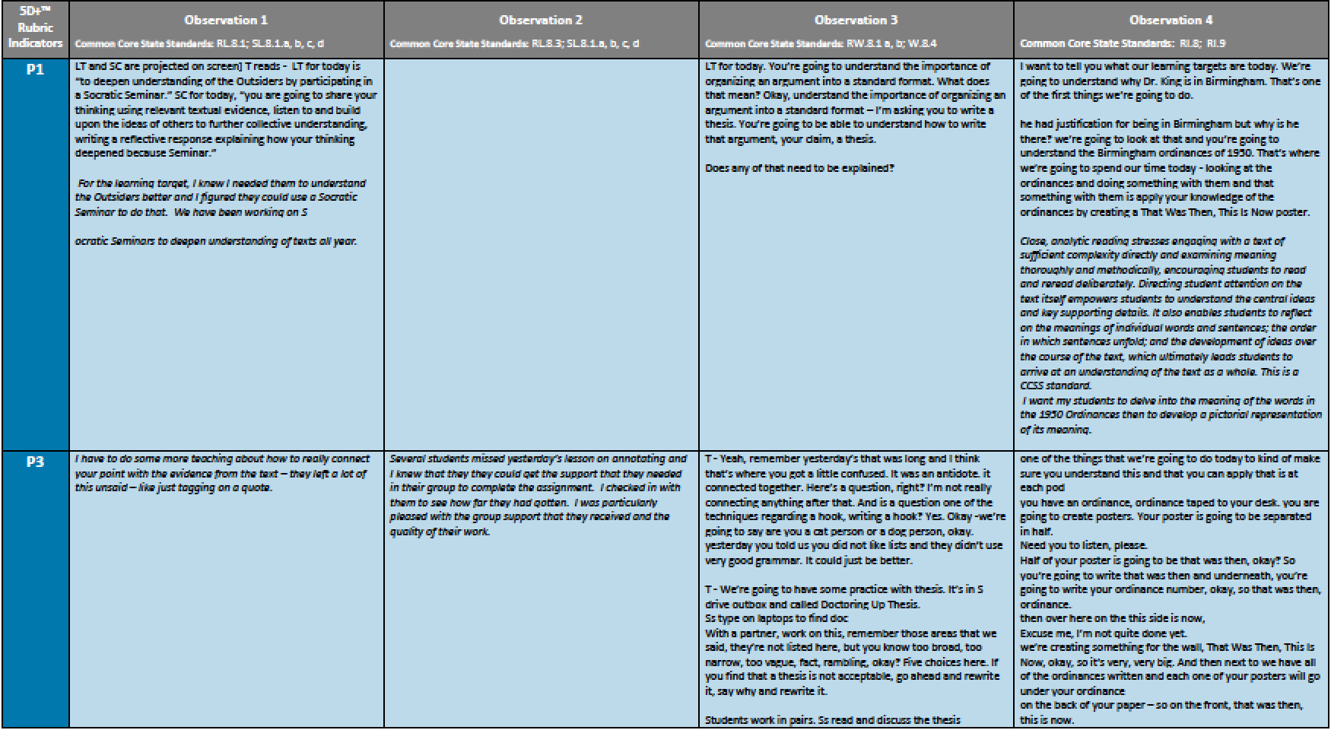
Matrix of Coded Evidence
Evidence that is coded by indicator code is captured in this matrix to complete mid and end-of-year summative scoring efficiently and accurately.

Slide 36
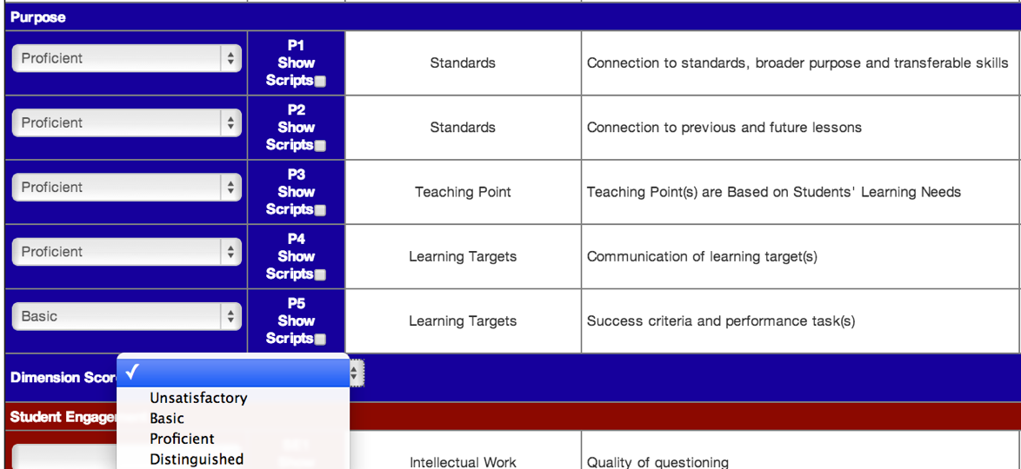
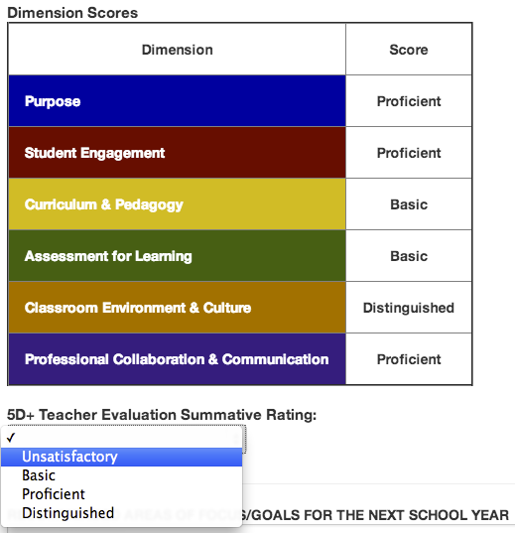
Indicator and Dimension Rating
Criterion scoring methodology based on preponderance and growth over time used to derive summative ratings.

Slide 37
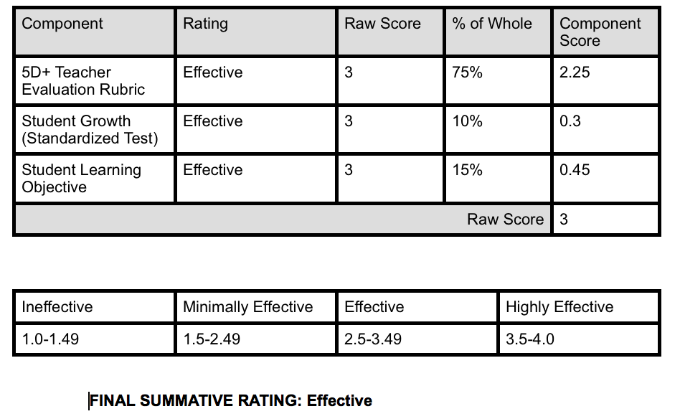
Final Summative Rating
Platform
Customizable calculator built into tool to combine professional practice ratings, student growth data, and other relevant data to derive a final effectiveness rating.

Slide 38
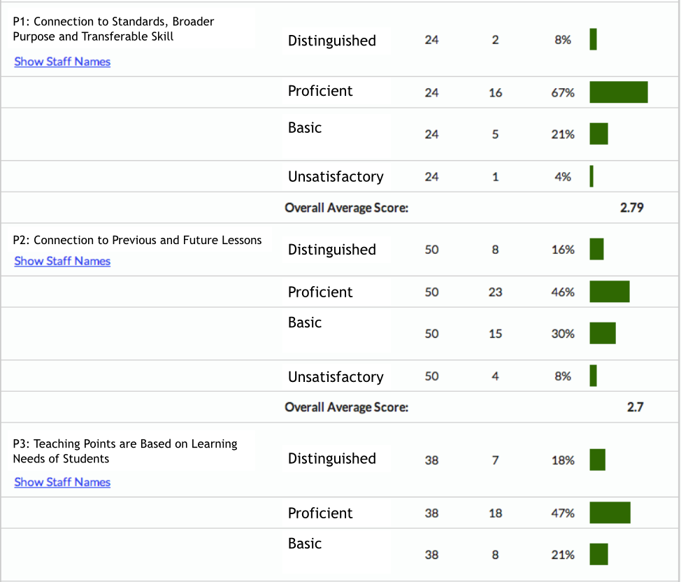
Platform

Slide 39
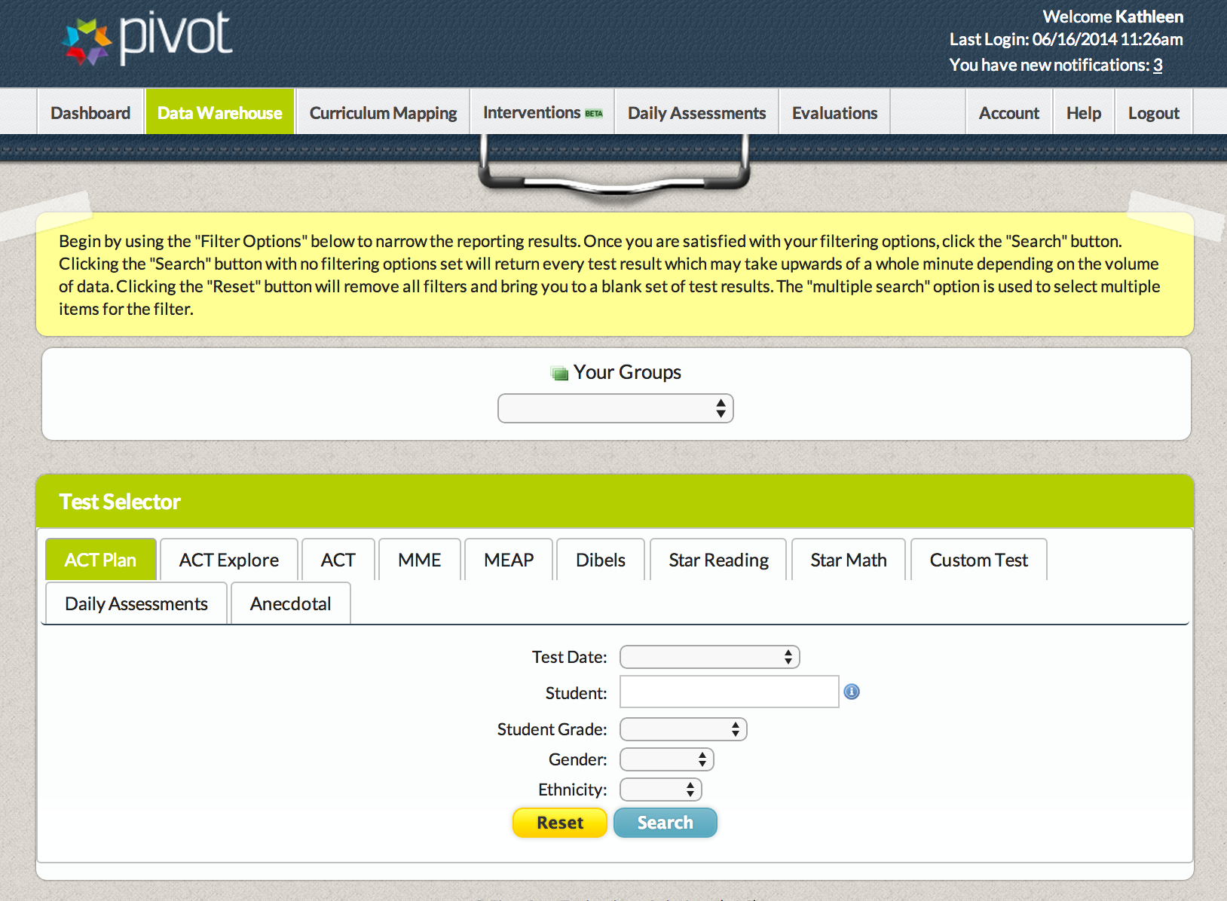
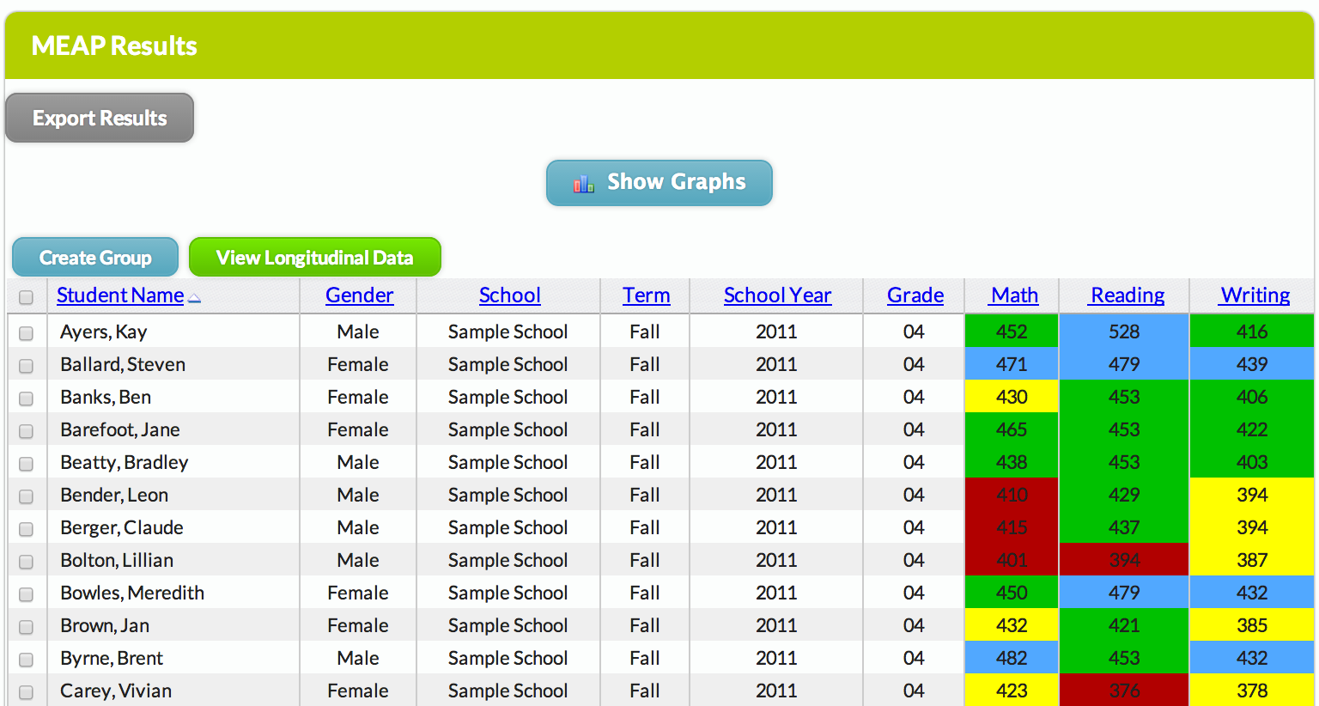
Platform (Optional)
Student Data
Longitudinal data assists administrators and teachers in identifying trends in student data.Graphically display and track interim and summative assessment results to quickly identify areas of strength and weakness in student learning. Color-coded results assist in quick recognition of individual student needs. Five Star imports all data for district, saving human and fiscal resources.

Slide 40
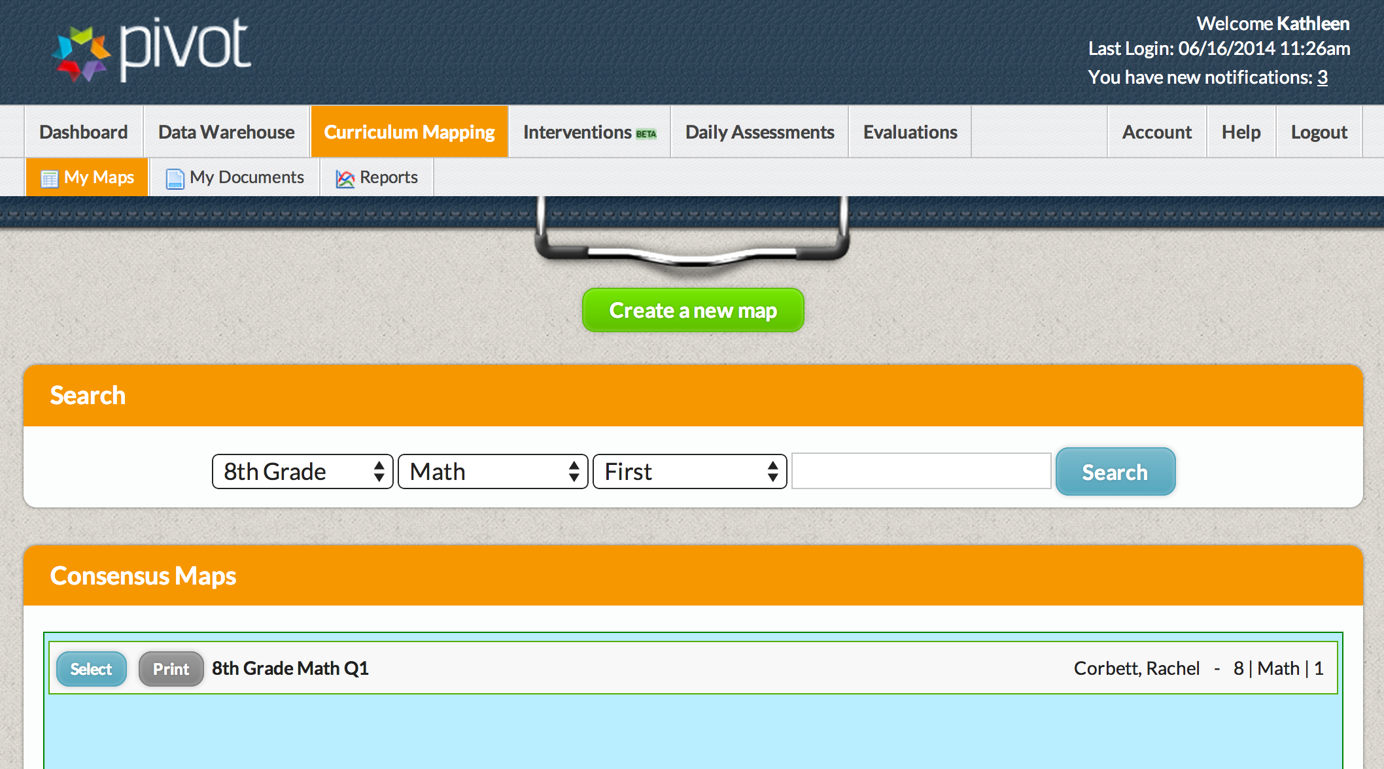
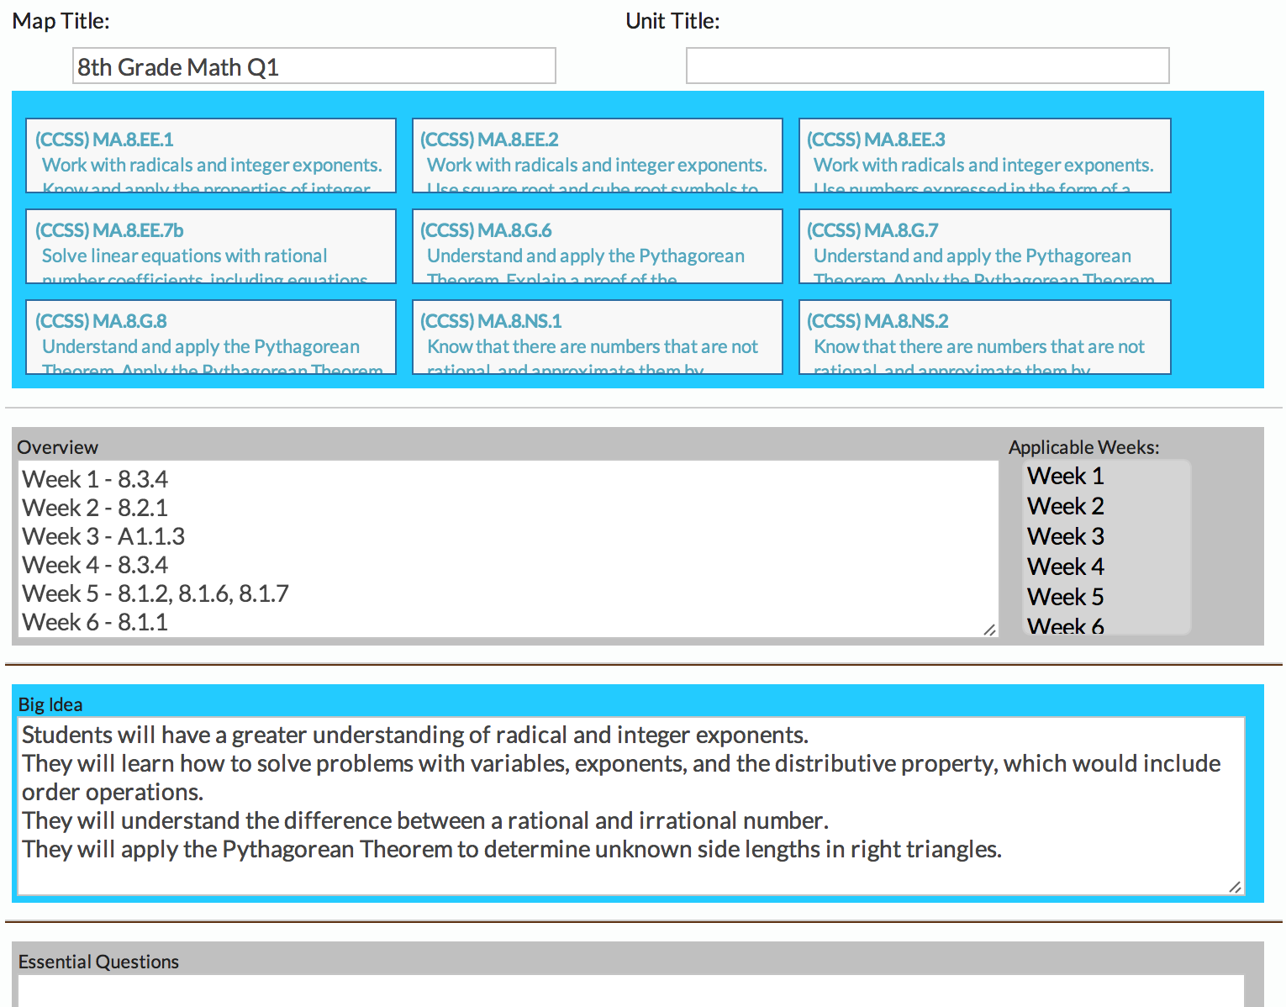
Platform (Optional)
Curriculum Mapping
Manage all district curriculum (scope/sequence, maps, UbD’s, etc.) in one place. Link all curriculum to Michigan content expectations (GLCE/HSCE) and/or Common Core State Standards (CCSS). Run curriculum analysis reports to monitor and adjust implementation.

Slide 41
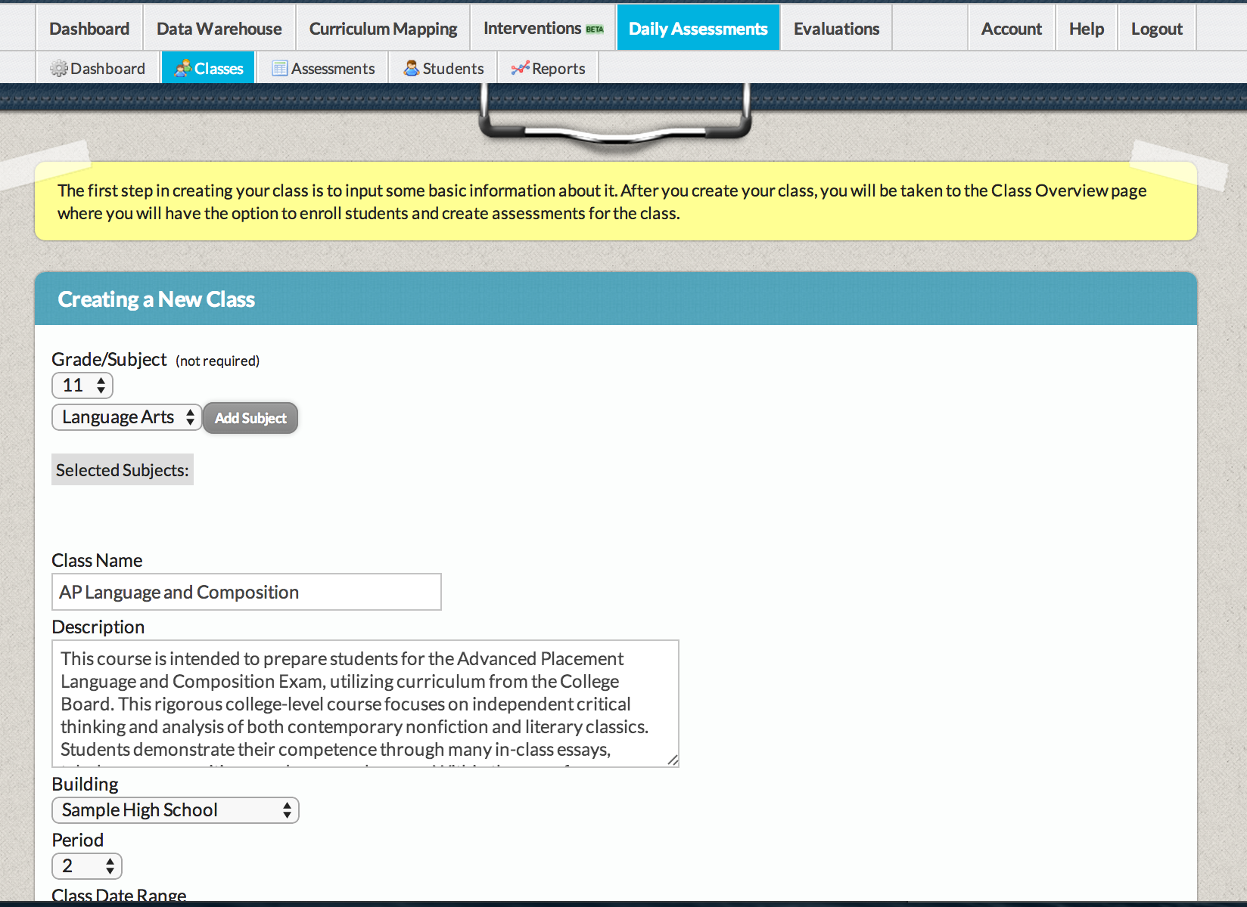
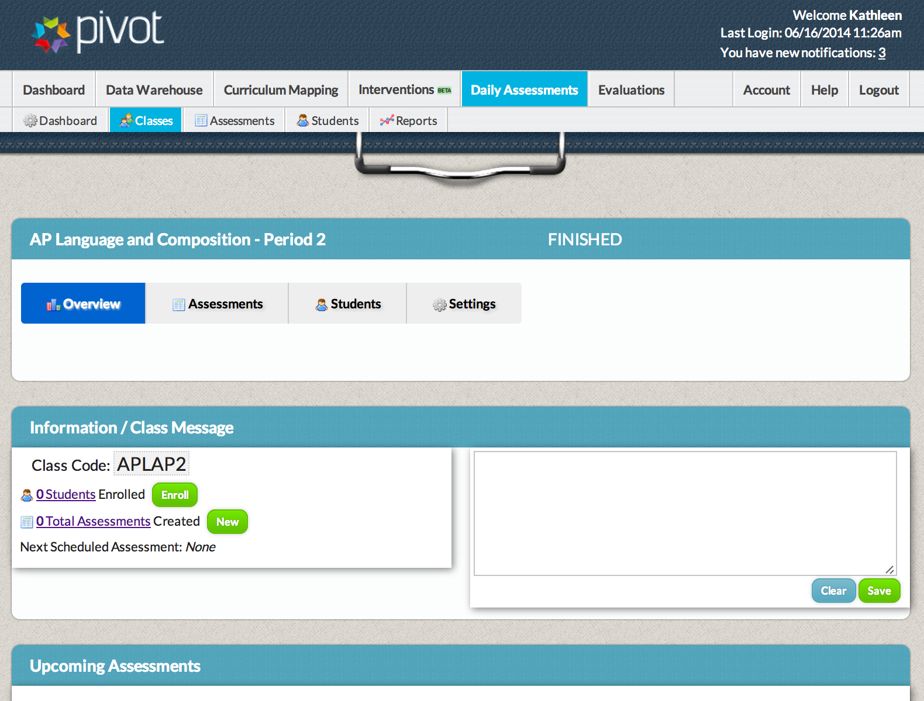
Platform (Optional)
Daily Assessments
Generate formative, interim and summative assessments (or use question bank) that are aligned with state content expectations and CCSS. Administer and score online assessments for quick results. Identify student, class, and course/grade level areas of strength and weakness.

Slide 42
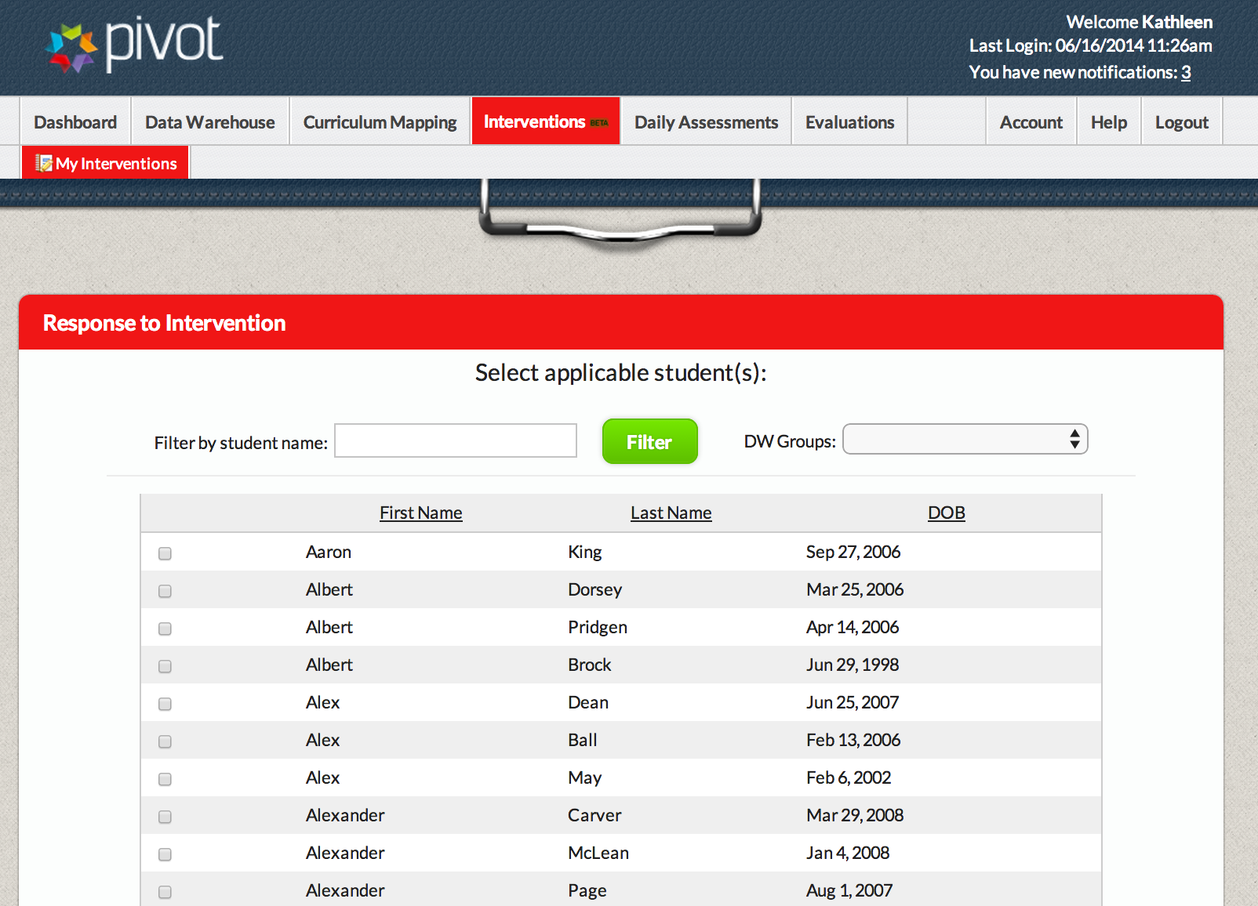
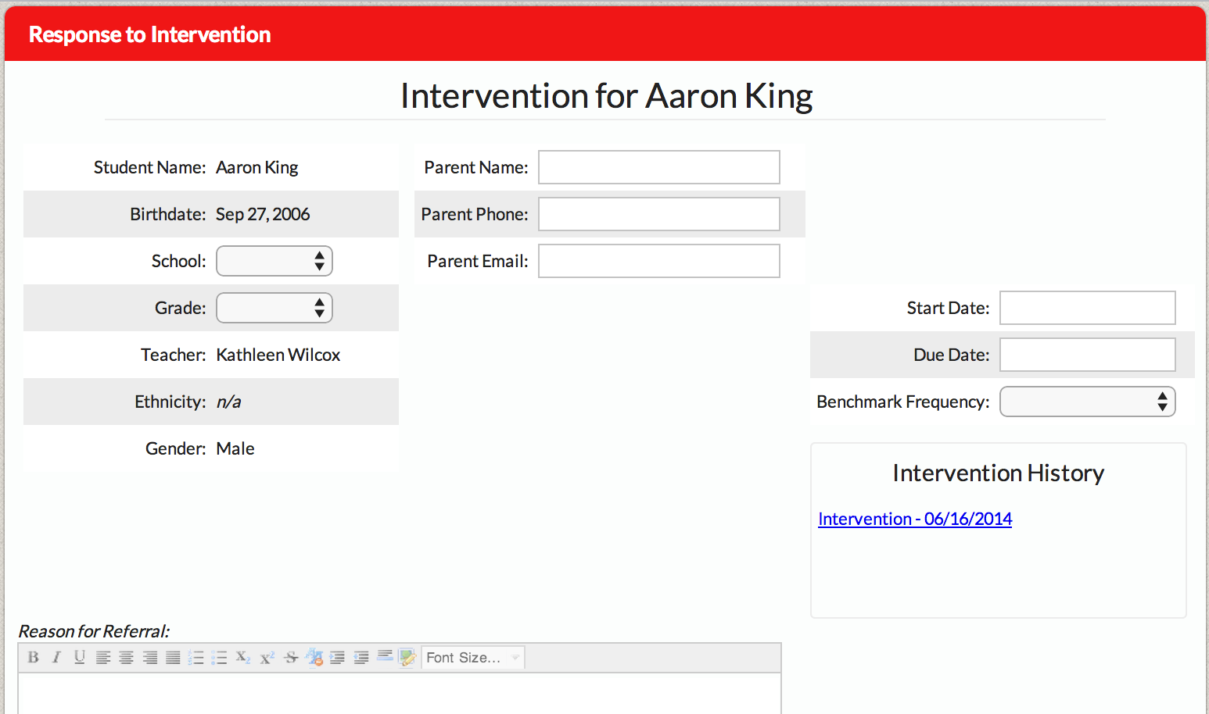
Platform (Optional)
Response to Intervention
Electronically manage the Response to Intervention (RtI) process. Track students and interventions in all tiers of system. Generate reports to progress monitor “what works” and doesn’t for each student.

Slide 43
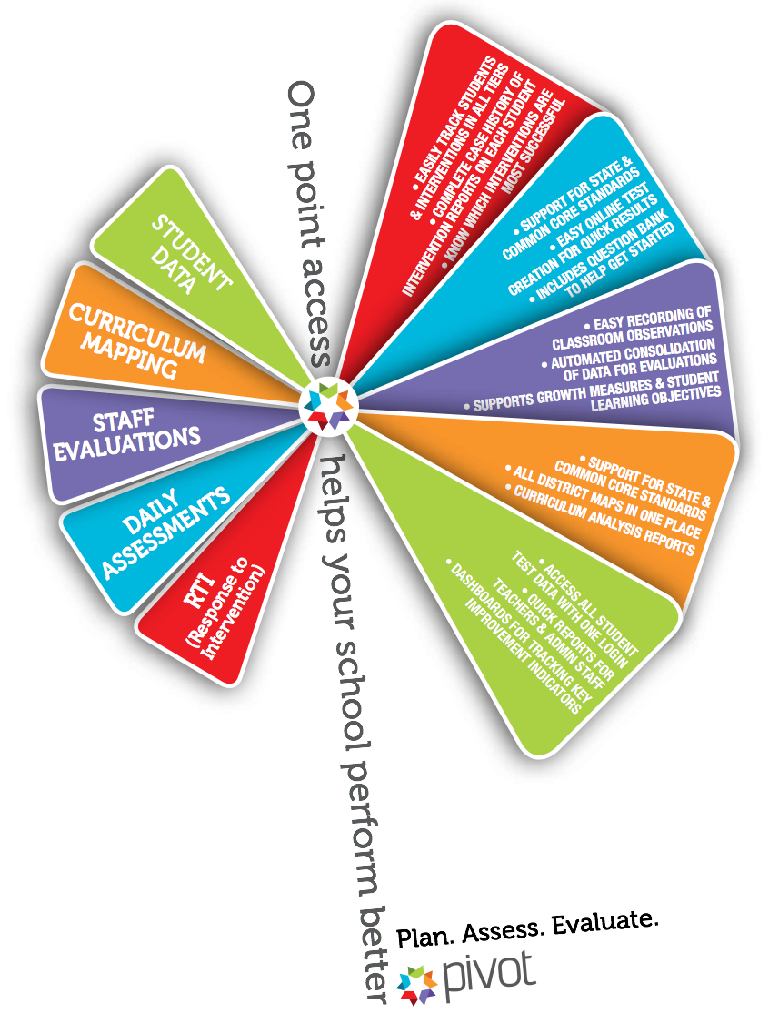
Platform

Slide 44
Cost Structure:
Initial Training
What: Framework Training
Who: Teachers, Teacher Leaders and/or Administrators
    $650/person at Regional Site (5 Days)
    $750/person at Regional Site bundled with Summative Scoring (6 days total)
    $3000/day in district ($15,000 for complete framework training or $18,000 for 6 days of framework training and 1 day of Summative Scoring)
        Note: If more than 30 participants attend an in-district training, an additional $100/person material fee is charged for each person beyond 30 or the district may provide materials at their expense.
    $79/person for Stage 1 (Day 1 content) and $99 for Stage II (Day 2-5 content)
When: Regional and In-District trainings occur throughout the year.
    It is recommended that the 1st two days of Framework training be scheduled back-to-back, followed by the remaining days in either 1 or 2 day increments six to eight weeks apart to allow time to deepen understanding in practice and apply learning.

Slide 45
Cost Structure
Optional/Recommended Training
What: Feedback Institute (2 days)
    $300/person at Regional Site
    $3000/day in district ($6,000)
Who: Teacher Leaders and/or Administrators
When: Regional and In-District trainings occur throughout the year.
What: Rater Reliability (3 days)
    $400/person at Regional Site
    $3000/day in district ($9,000)
Who: Evaluators
When: Regional and In-District trainings occur throughout the year.

Slide 46
Cost Structure
Electronic Tool
Pivot with 5D+: $450/evaluator 1st year
    $250/evaluator annual renewal
Each Additional Module (Optional): $2/student
    $1/student if bundled with 5D+ and purchased by June 30, 2015
Initial Training:
    Live Webinars allocated based on size of district and scheduled/provided for district at no charge.
    FREE Screencasts available on Youtube and Vimeo
    Nuts and Bolts Sessions at Regional Sites/In-District when requested.

Slide 47
Cost Scenario
District : 2,500 students and 11 administrators
  3 Elementary buildings - 1 principal
    3 admin($450 electronic tool + $650 framework training) = $3300
  2 MS buildings- 1 principal/ 1 assistant
    4 admin($450 electronic tool + $650 framework training) = $4400
  1 HS building/ 1 principal/ 2 assistants
    4 admin($450 electronic tool + $650 framework training) = $4400
  Total for District - 1st Year Electronic Tool and Framework Training
    11admin($450 electronic tool + $650 framework training) = $11,100
  Total Initial Cost to district for framework training and use of electronic tool.
  Annual Cost after 1st year
    11 admin ($250 electronic tool) = $2,750

Slide 48
Additional Resources
www.k-12leadership.org or www.k-12leadership.org/teacher-eval
On the website you can find:
5D Instructional Framework.
5D+ Teacher Evaluation Rubric in multiple formats.
5D+ Readiness Assessment.
Glossary of Terms.
Research and Resources to Support the 5D+ Teacher Evaluation Rubric.
Rater Reliability Research Overview.
Teacher Evaluation Research.
Annotated Bibliography.
Leading for Instructional Improvement: How Successful Leaders Develop Teaching and Learning Expertise, by Fink and Markholt.
Classroom Instruction Videos.

Slide 49



Reflection
What squares with you?
What questions are circling in your mind?
What changes in practice or expectations do you need to consider with 5D/5D+?

Slide 50
MI School Representative
  Greenville Public Schools (1st year) 616.754.3686
    Michelle Blaszczynski, Chief Academic Officer
        blaszczm@greenville.k12.mi.us
    Korie Crawford, Chief Operating Officer
      crawfork@greenville.k12.mi.us
Reflections:
  Why did you select this model?
  What was your experience with launch?
  What are some highlights to date?

Slide 51
Question and Answers

Slide 52
Contact Us
  For MASSP services and MI implementation, contact:
    Colin Ripmaster, Associate Director
    Michigan Association of Secondary School Principals
    colinr@michiganprincipals.org
    517-327-5315
    www.mymassp.com
  For CEL services, contact:
    Patty Maxfield, Director of Teacher Evaluation
    Center for Educational Leadership
    edlead@uw.edu
    866-577-8066
    www.k-12leadership.org

